Slide 1
Audio Emotion Detection Based on CNN & CRNN
— Presented by Team 2: Gorden Li 489716

Slide 2
Introduction
Research Design
CONTENTS
Data, Model and Results
Conclusion and Prospect

Slide 3
Introduction
01
Motivation of the study
Goal of the study

Slide 4



Motivation of Study
Around 90% of information we get is from audio. In business, audio information is also a very essential source of information.

Slide 5



Goal of Study
Generate models to identify audio emotion.
Psychologically Defined Emotion
Neutral
Sad
Fearful
Happy
Disgust
Angry
Calm
Notes:
Definition of emotion

Slide 6
Research Design
02
Problem Description
Methodology

Slide 7
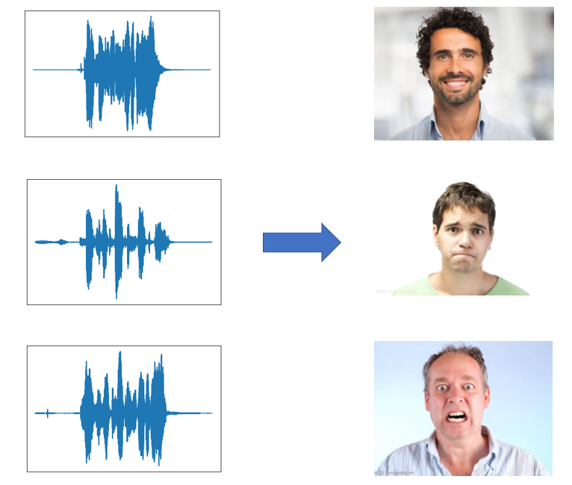
Problem Description
The purpose of the study is to identify the emotion based on the audio wave.
The actual problem of this research going to solve is to classify the audio wave to specific emotion.

Slide 8
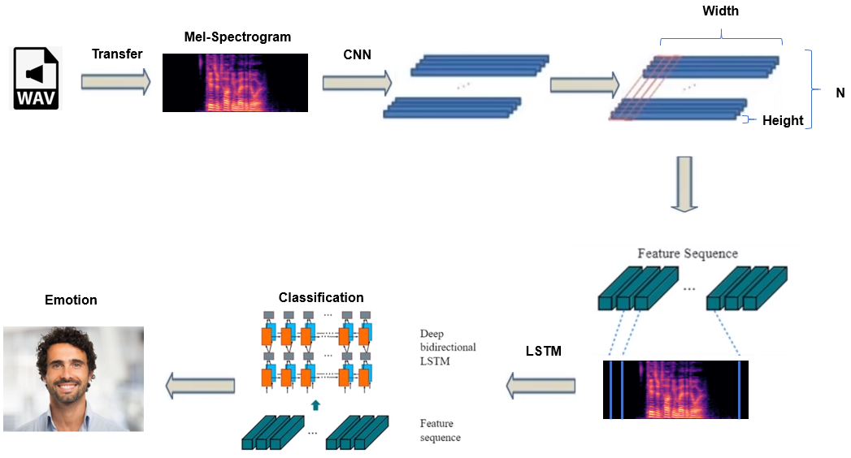
Methodology
CNN is used to extract information from spectrogram of wav and LSTM is used to classify emotion.
CNN Model
CRNN Model
Notes:
How do we deal with these audio information and finally get a classification
Brief
Concept will be discussed
Transfer map to sequence

Slide 9
Data, Model and Results
03
Data Selection and Preprocess
Model Design and Results
Notes:
Deep look

Slide 10
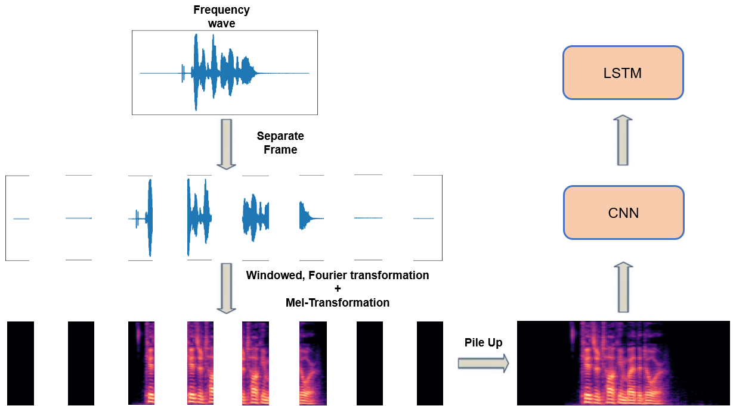

Data Selection and Preprocess
Ryerson Audio-Visual Database of Emotional Speech and Song(RAVDESS) is used. It is recorded by professional actors, covering 1440 samples, with 8 emotions
Notes:
What’s the data
How we preprocess?
Difference between wave & pectrogram
One thing focus: I use Mel

Slide 11
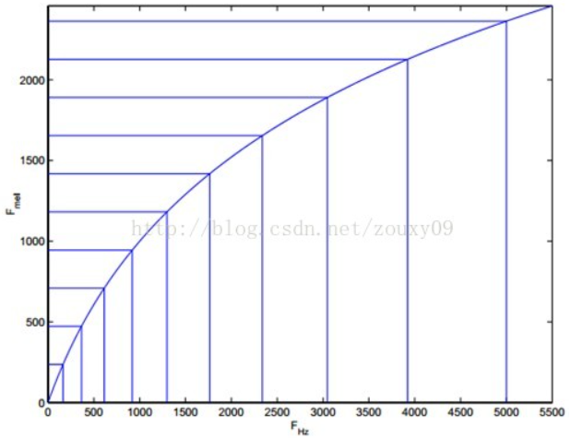

Data Selection and Preprocess
Mel-Spectrogram is used to simulate a non-linearity relation between the tone human hear and frequency of the tone
$$mel\left(f\right)=2595∗\log_{10}\left(1+\frac{f}{700}\right)$$
Notes:
Relation: X means Y means
2 time hear-doubled

Slide 12
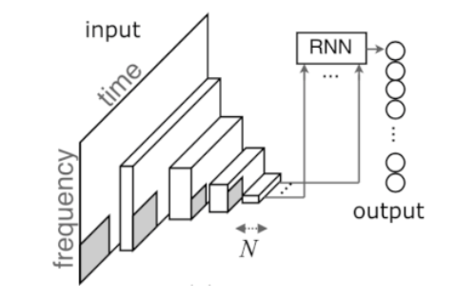
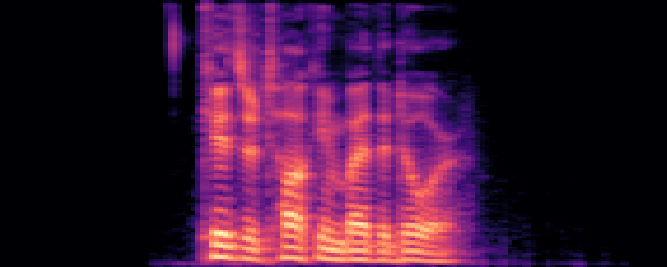

Model Design and Results
The CRNN model contains two parts. Extraction of feature in CNN and classification in LSTM.
Input
LSTM
Time
Frequency
Emotion Classification
CNN
CNN | Extract abundant information from a spectrogram
LSTM | Simulate continuity of emotion and avoid vanishing/exploding gradient
Short-time energy and zero-cross ratio
Merit
Notes:
LSTM:Gates

Slide 13
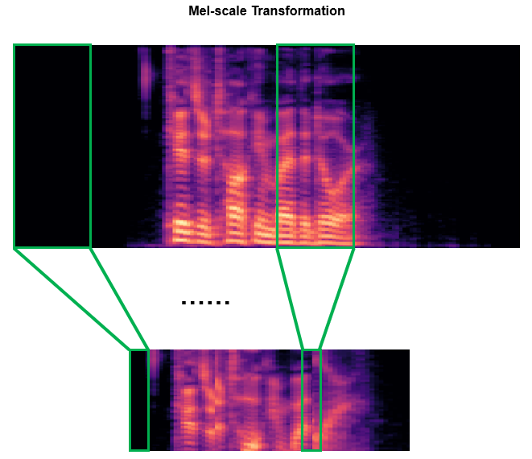
Model Design and Results
In CNN, 1 dimension convolution is applied on time scale when extracting the feature
Notes:
Not only a figure, but a sequence

Slide 14
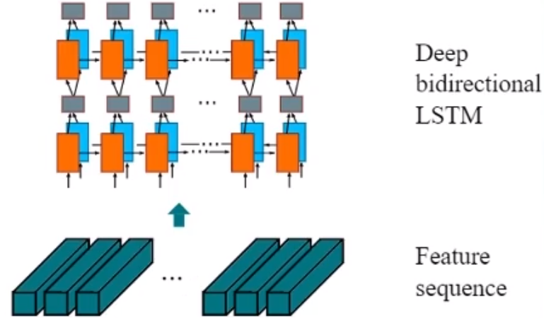
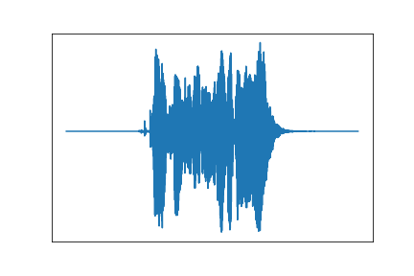
Model Design and Results
In LSTM, Bidirectional-LSTM is used to simulate the continuity of real human emotion.
Notes:
Happy, before actually laugh out, our tone increase
Status of happiness last the whole process
Status 1 sec ago
Property of bidirectional feeback

Slide 15
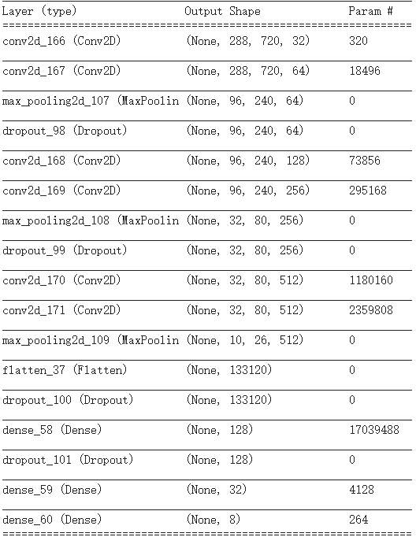
Model Design and Results
In CNN model, relu function is used to avoid vanishing gradient. Dropout/Early Stop is used to avoid overfitting. Theses improvement increase accuracy rate of the model.
Type | Configurations
Input | 288*720*1
Convolution | Maps:32, K:3X3, S:1, P:1, relu
Convolution | Maps:64, K:3X3, S:1, P:1, relu
MaxPooling | Window:3X3, S:3
Dropout | Dropout:0.4
Convolution | Maps:128, K:3X3, S:1, P:1, relu
Convolution | Maps:256, K:3X3, S:1, P:1, relu
MaxPooling | Window:3X3, S:3
Dropout | Dropout:0.4
Convolution | Maps:512, K:3X3, S:1, P:1, relu
Convolution | Maps:512, K:3X3, S:1, P:1, relu
MaxPooling | Window:3X3, S:3
Flatten() | ---
Dropout | Dropout:0.25
Dense | Neural: 128, relu, L2 regularization
Dropout | Dropout:0.25
Dense | Neural: 32, relu
Dense | Neural: 8, softmax
Training | EarlyStop, categorical_crossentropy
Notes:
How do I get dropout rate = 0.4
I train model several times since initial weight was set randomly in case goto local potimal

Slide 16
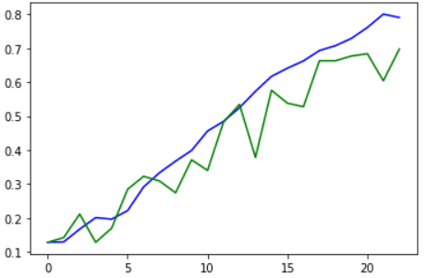
Model Design and Results
The final accuracy of CNN model reaches 70% after improvement
Train
Val
Accuracy Rate
Epochs

Slide 17
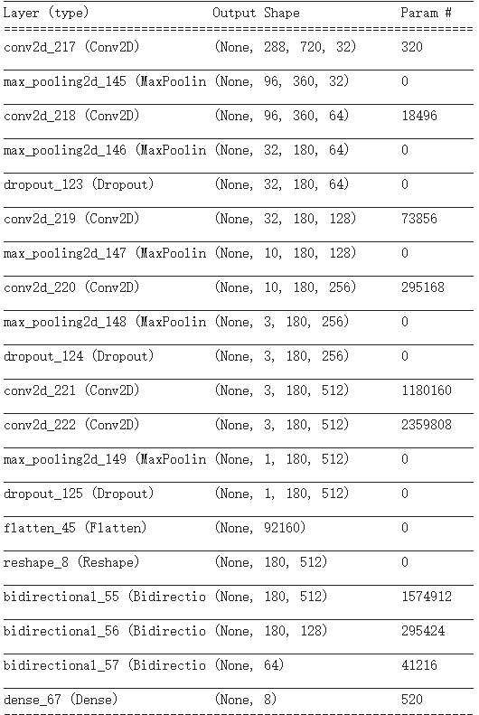
Model Design and Results
In CRNN model, relu function, dropout and early stop is also used
Type | Configurations
Input | 288*720*1
Convolution | Maps:32, K:3X1, S:1, P:1, relu
MaxPooling | Window:3X2
Convolution | Maps:64, K:3X1, S:1, P:1, relu
MaxPooling | Window:3X2
Dropout | Dropout:0.4
Convolution | Maps:128, K:3X1, S:1, P:1, relu
MaxPooling | Window:3X1
Convolution | Maps:256, K:3X1, S:1, P:1, relu
MaxPooling | Window:3X1
Dropout | Dropout:0.4
Convolution | Maps:512, K:3X1, S:1, P:1, relu
Convolution | Maps:512, K:3X1, S:1, P:1, relu
MaxPooling | Window:3X1
Dropout | Dropout:0.3
Flatten() | ---
Map_to_Sequence | 1*180*512
Bidirectional-LSTM | Hidden_units:256, Dropout:0.2, Recurrent_dropout:0.2
Bidirectional-LSTM | Hidden_units:64, Dropout:0.2, Recurrent_dropout:0.2
Bidirectional-LSTM | Hidden_units:16
Dense | Neural: 8, softmax
Training | EarlyStop, categorical_crossentropy

Slide 18
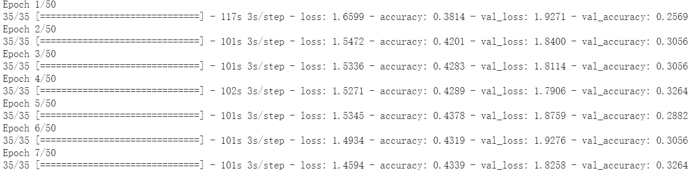
Model Design and Results
The final accuracy of CRNN still need to be imporved
Epochs
Notes:
CRNN does not work very well
Ideally it should be better than CNN
I though of what happen. Transferring map to sequence. Look into frame instead of directly pooling it to make the sequence more detailed
I will focus on this problem in my further study in the future

Slide 19
04
Conclusion and Prospect

Slide 20



Conclusion and Prospect
Emotion detection can be applied in a lot of real life scenarios
1440 3-second audio with 8 emotions used
Positive?
Negative?
CNN
CRNN (CNN+Bi-LSTM)
Improve the process of interview
70+%
50%

Slide 21

Thanks !

